Slide 1






An Introduction to Machine Learning
Welcome to this week’s workshop!
9 October 2024
About us
mcmasterai.com

Slide 2


Brief Introduction
Vraj Patel – Computer Engineering – 3rd Year
George Ghiugan – Computer Science – 2nd Year
Tamilla Zeynalova – Computer Science – 2nd Year
Jasraj Johal – Computer Science – 3rd Year
Kirit Mand – Computer Engineering – 3rd Year
Japneet Singh – Computer Science – 3rd Year

Slide 3

Agenda
1. What is Machine Learning
2. Types of Machine Learning
3. Real World Applications
4. Demo Creation
5. Kahoot Time

Slide 4
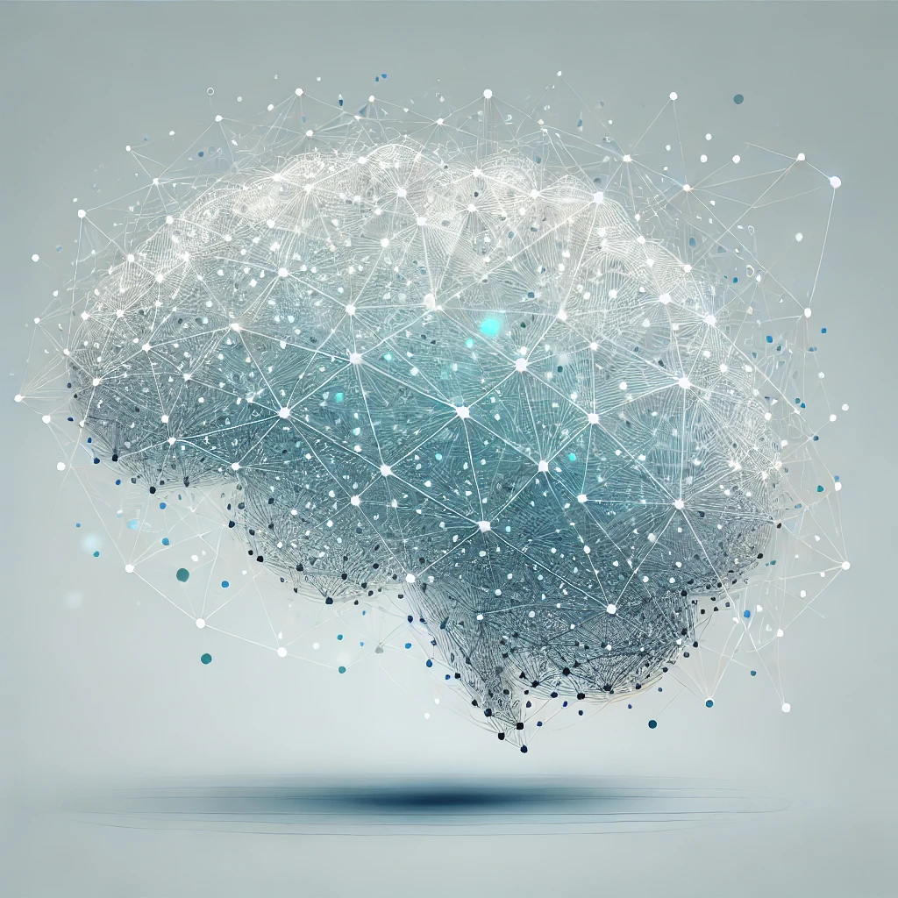

What is
Machine Learning?
Learning is any process by which a system improves performance from experience
- Herbert Simon
Placeholder for image
AI that learns from data to find patterns
Data
Algorithm/Model
Prediction

Slide 5

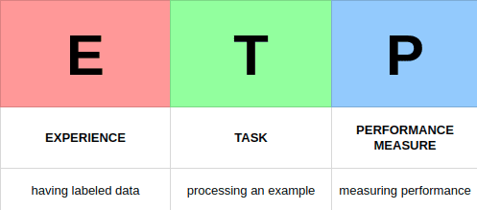
Definition
By Tom Mitchell
A computer program learns from →
💡 Experience (E)
✔ Tasks (T)
📈 Performance (P)
Learning task = <T,P,E>

Slide 6
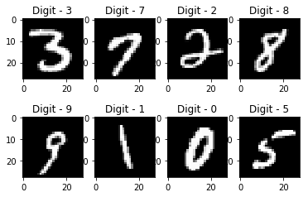
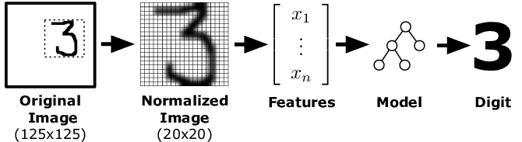
Handwriting recognition
💡 Experience (E) - Dataset of handwritten words with labels
✔ Tasks (T) - Recognizing handwritten words in images
📈 Performance (P) - Percent of correctly classified words

Slide 7

Types Of
Machine Learning
Based on human supervision
01
02
03
04
Supervised
Unsupervised
Semi-Supervised
Reinforcement

Slide 8
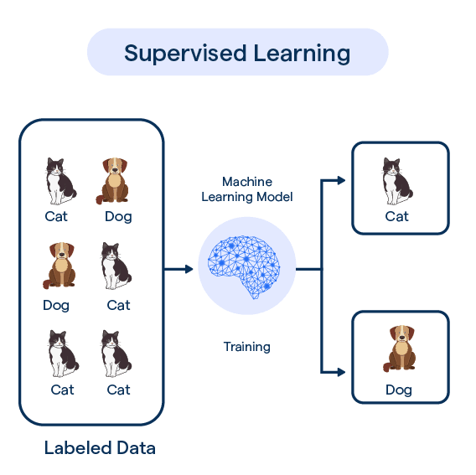
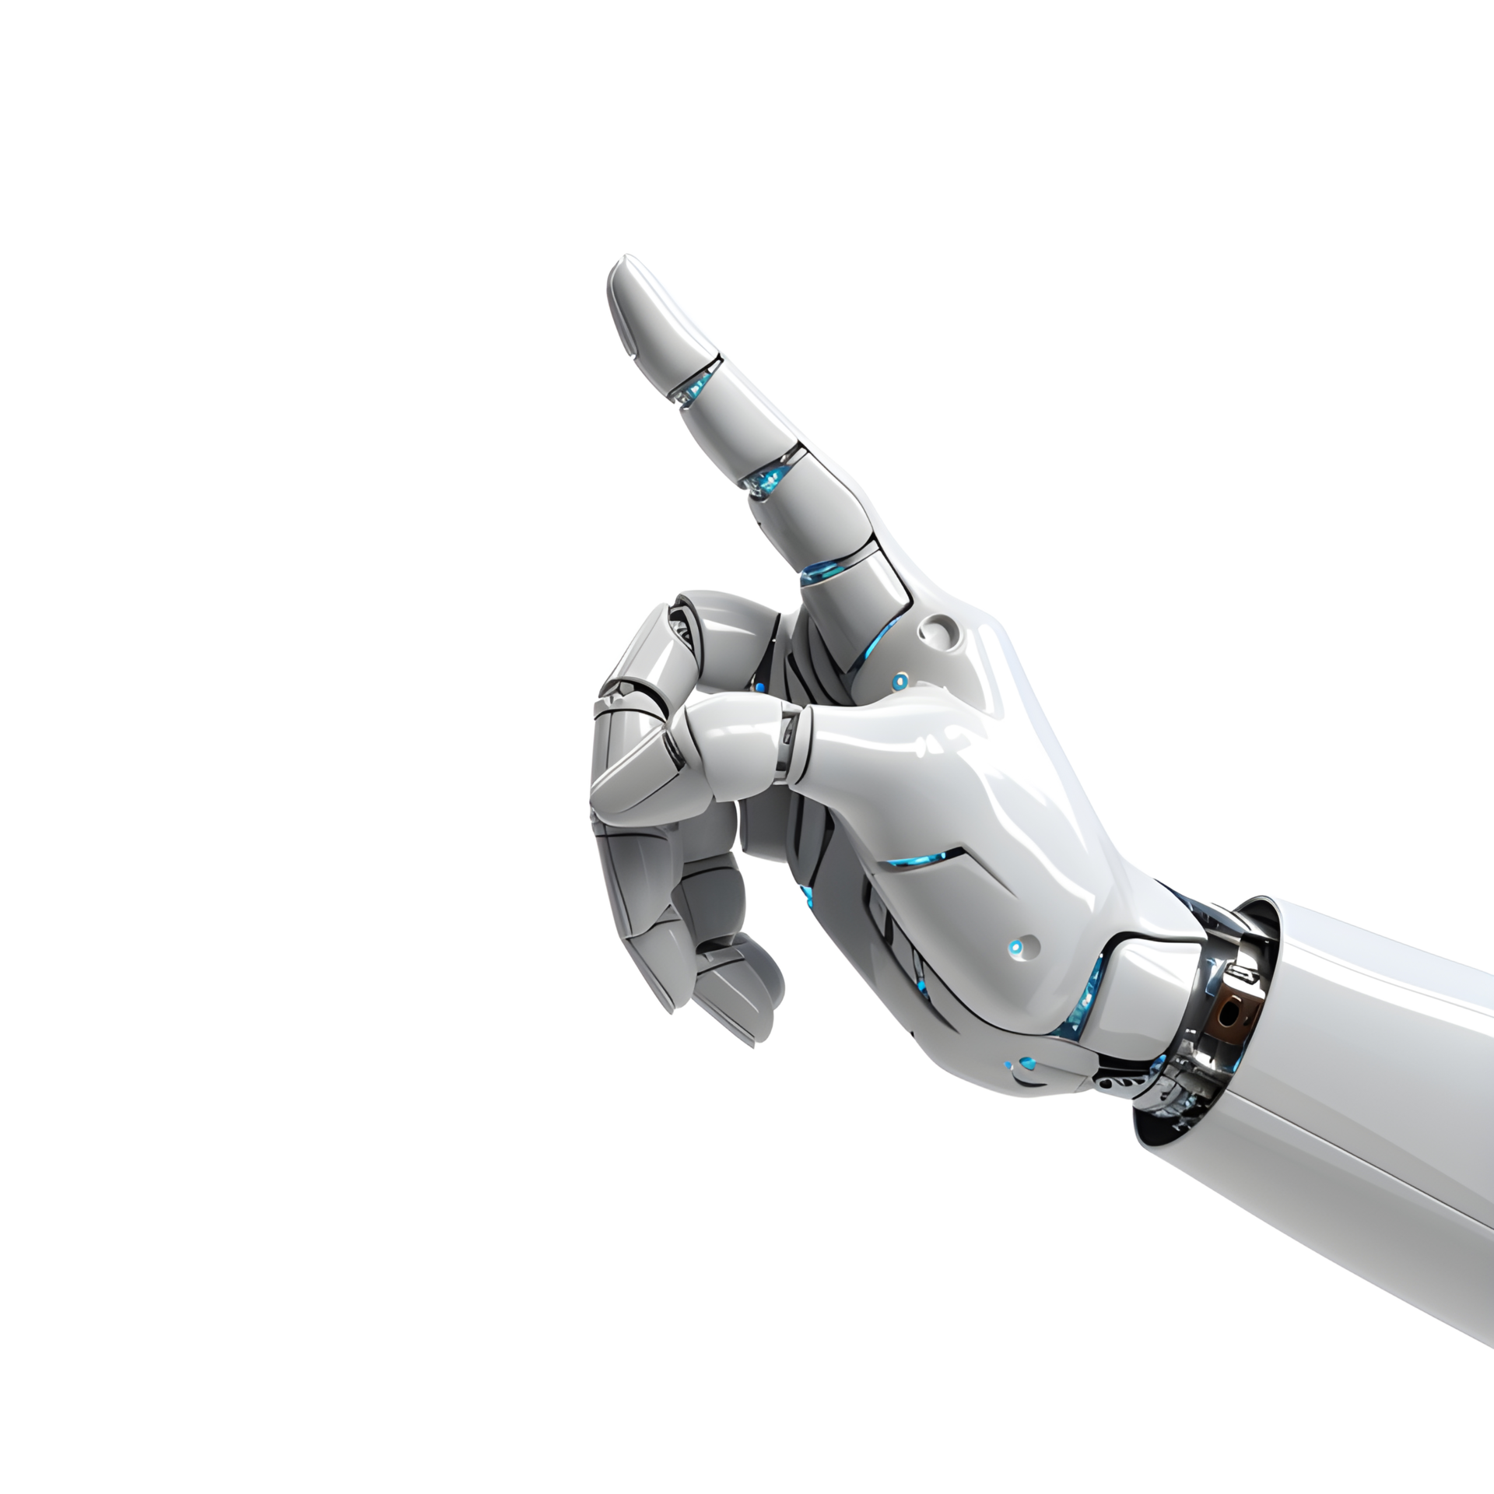
Supervised Learning
A type of machine learning where a model learns from labeled data.
The model is given an input and the correct output so it can learn the pattern. After training, the model can make predictions on new data.
Two types:
Classification: Predicts categories.
Regression: Predicts numbers.

Slide 9
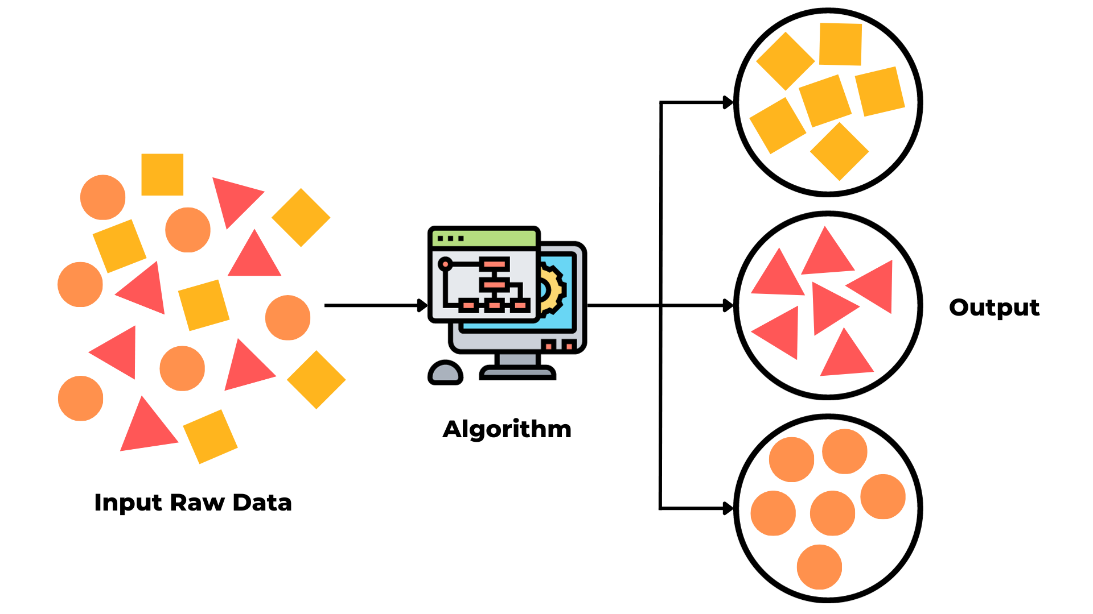
Unsupervised Learning
A type of machine learning where a model learns from unlabeled data.
The model is given input data but no correct output, so it identifies hidden patterns or groupings on its own.
Typically used when labeled data is unavailable or scarce but we still want to understand the data structure

Slide 10
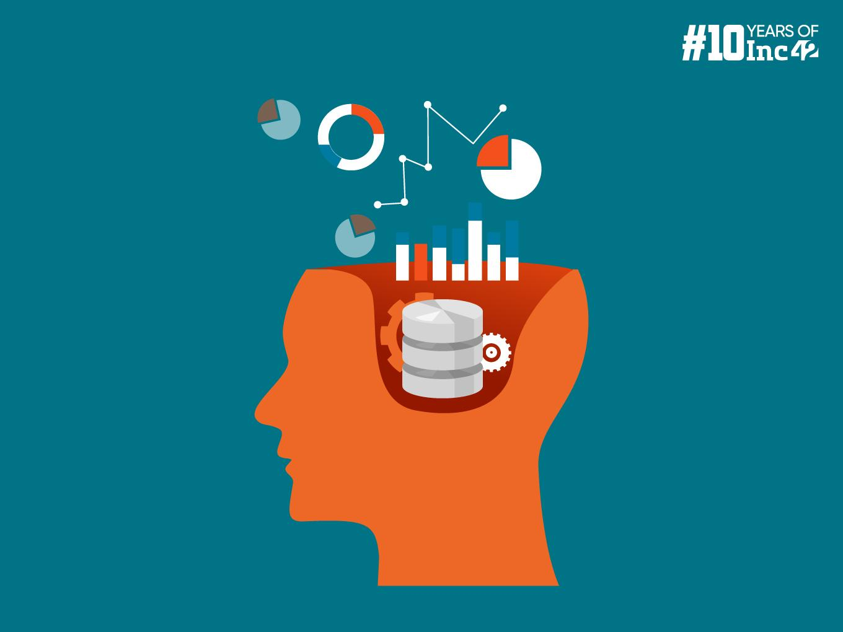

Semi-Supervised
As the name suggests, it slightly uses Supervised learning
Utilizes labeled data for initial predictions and then unlabeled data to learn the “shape” of larger data distribution
Typically utilizes when labeled data is scarce BUT unlabelled data follows suite

Slide 11
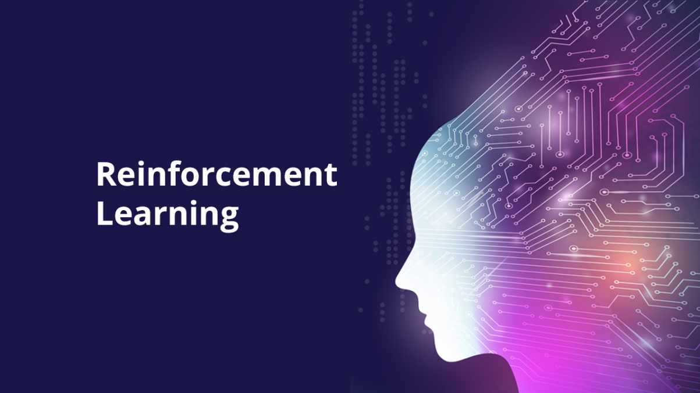
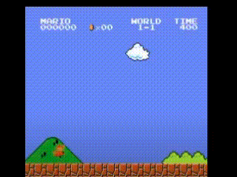
Reinforcement Learning
Typically, different from your “normal” type of ML
Agent makes decisions based on interactions with environment
Actions, States, Rewards
A pretty cool project: Mario playing by itself

Slide 12

Real World
Applications
Healthcare and Medical Diagnosis
Natural Language Processing (NLP)
Autonomous Vehicles
Finance and Banking

Slide 13
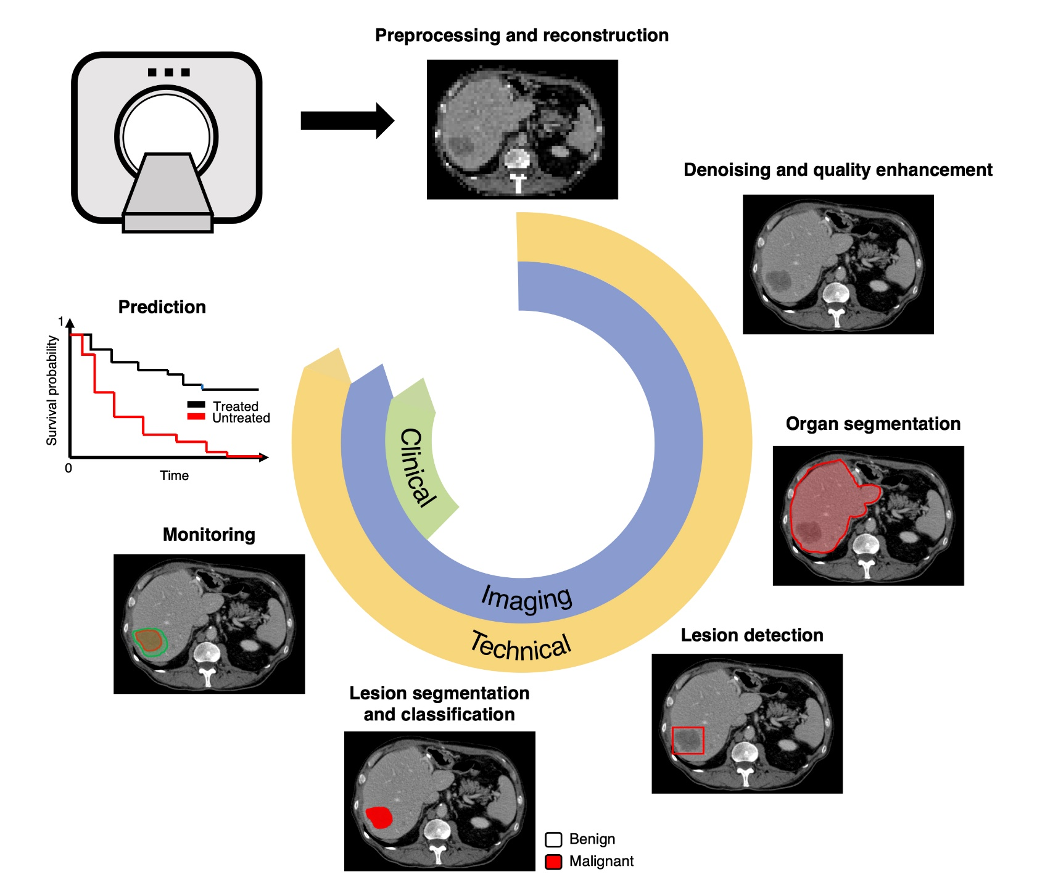
Healthcare and Medical Diagnosis
Medical Imaging: ML algorithms used in interpreting X-rays, MRIs, and CT scans for diagnosis detection.
Predictive Diagnostics: ML models analyze patient data to predict disease outbreaks, treatment outcomes, and readmission rates
Deep Learning Workflow in Radiology

Slide 14

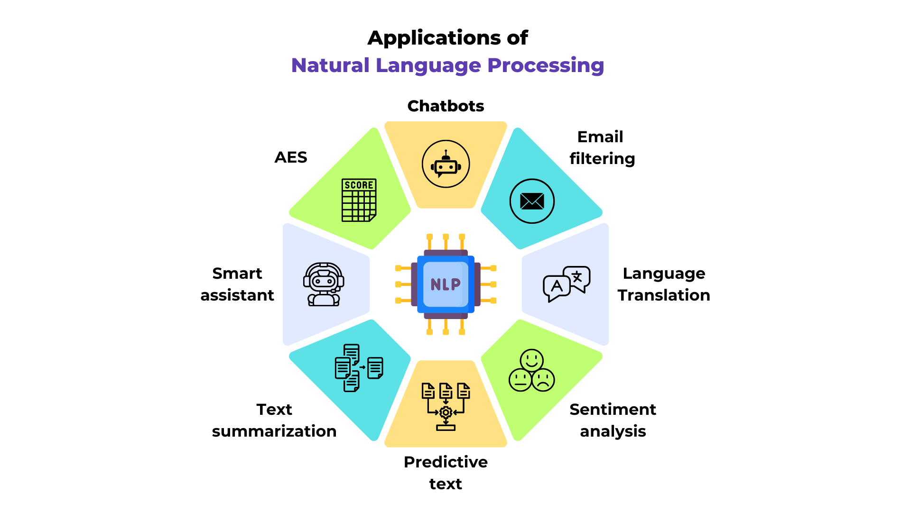

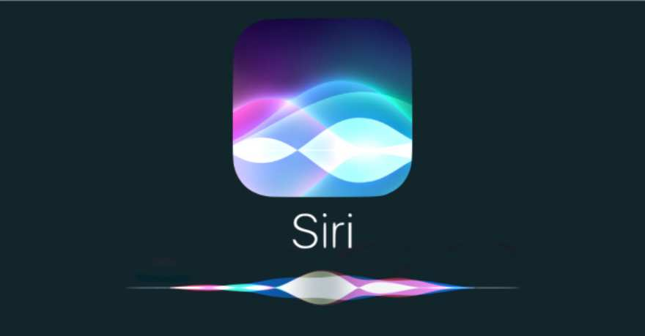
Natural Language Processing (NLP)
Chatbots and Virtual Assistants: Systems like Siri, Alexa, and Google Assistant use machine learning to understand spoken language, answer questions, and perform tasks.

Slide 15
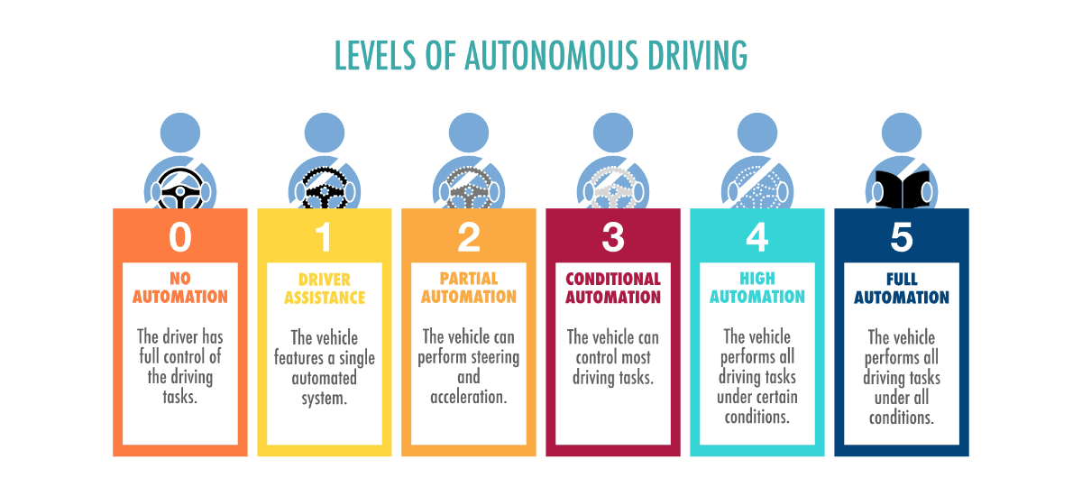
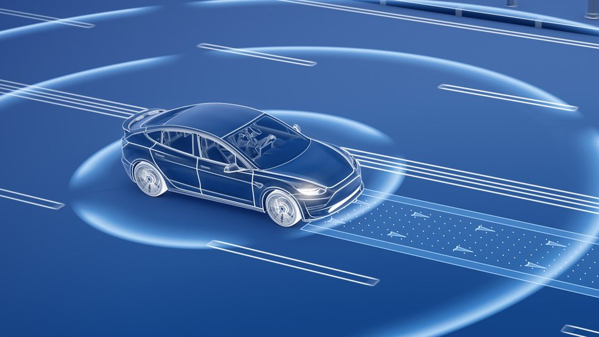
Autonomous Vehicles
Self-Driving Cars: ML models enable cars to understand their surroundings, make decisions, and learn from real-world driving conditions.
Navigation and Traffic Prediction: ML helps optimize routes, avoid traffic, and improve fuel efficiency.

Slide 16
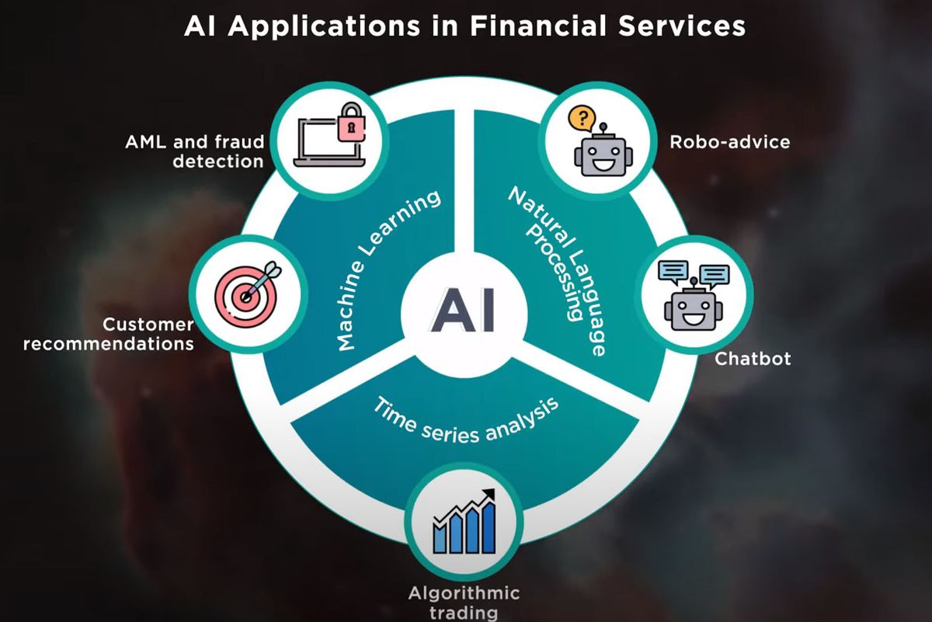
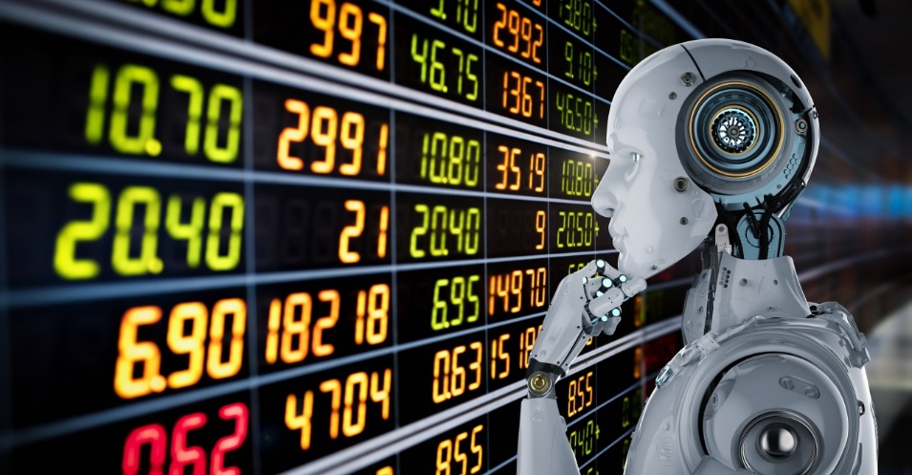
Finance and Banking
Fraud Detection: Used in identifying unusual transactions and patterns that might indicate fraud.
Algorithmic Trading: ML algorithms to analyze vast amounts of market data and make high-frequency trades automatically.

Slide 17
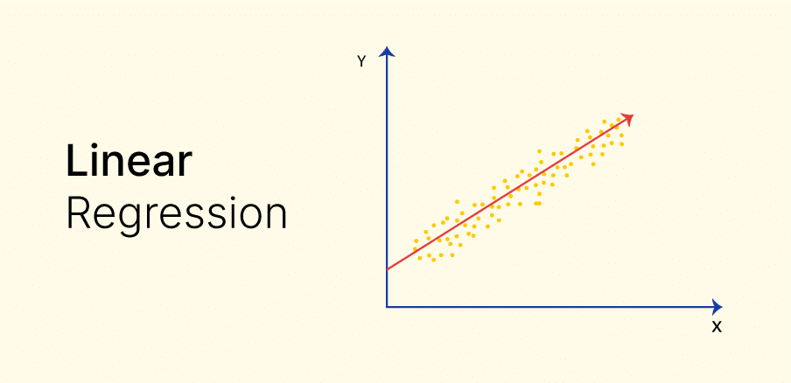
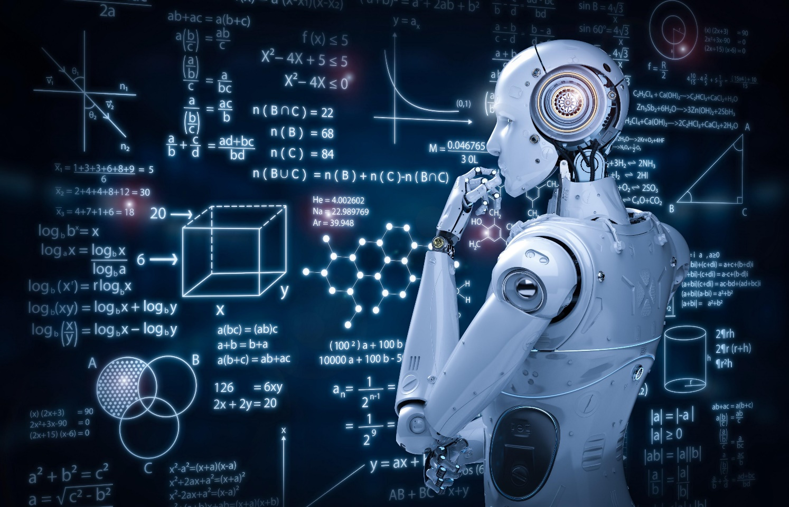


Linear Regression
One of the many ML Algorithms out there
Very trivial Conceptually
Predict (value) based on relationship between 2 variables, input and output
Obviously: As the name suggests, it’s a linear relationship.
Think of it like a line of best fit – regression line
- Multiple Real-World Applications…
Today’s Demo will consist of exactly this Algorithm!!

Slide 18

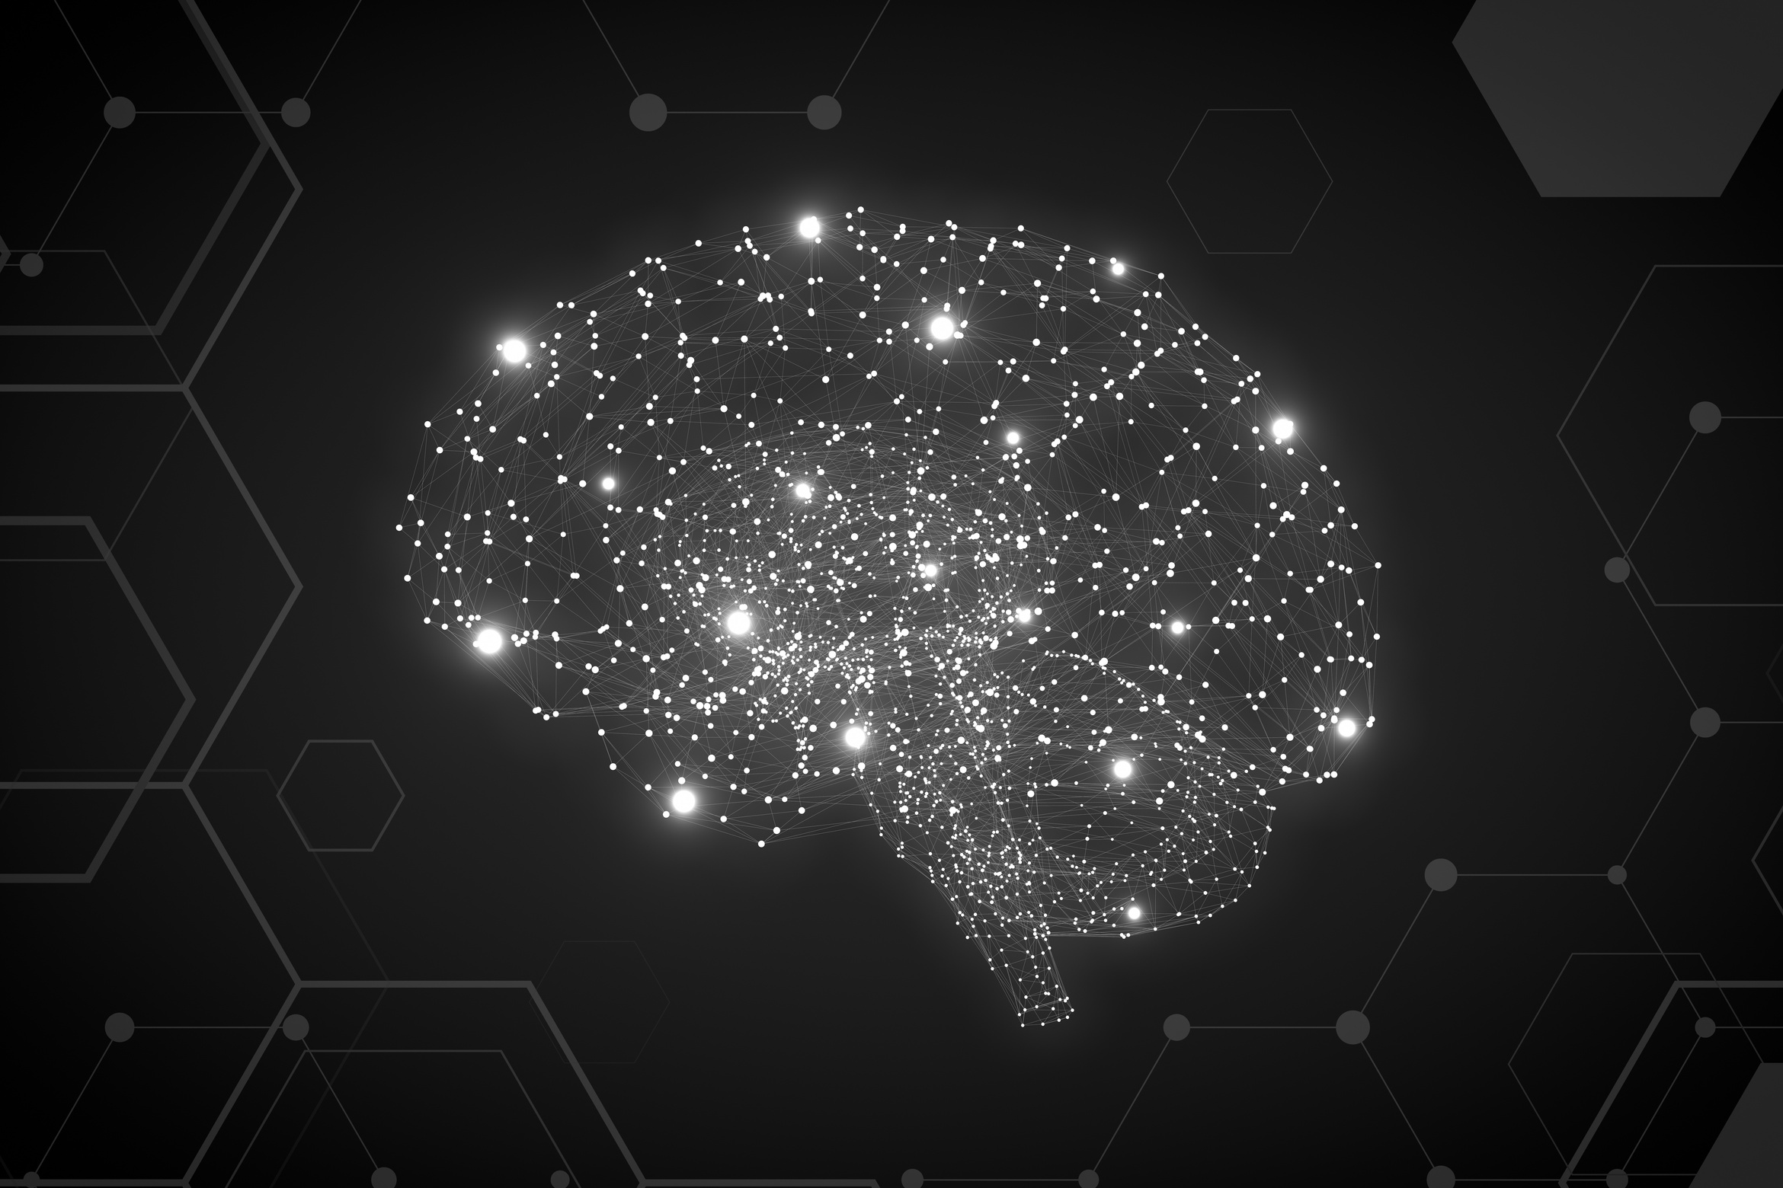
Kahoot!
The Link should be put into the chat.

Slide 19



Thank you
More Information
https://github.com/patev61/MacAIEducation2024
Feedback Link: https://forms.gle/hJmQ9zC9tt8VhNsa7

